Slide 1








AIR QUALITY DASHBOARD
Breath Cleaner, Live Healthier

Slide 2




Problem Statement
“Dashboard for real time air pollution monitoring system”
Build an AI-powered Air Pollution Dashboard that makes air quality data engaging, interactive, and actionable — using smart insights, real-time visuals, and gamified awareness to drive eco-conscious behavior

Slide 3
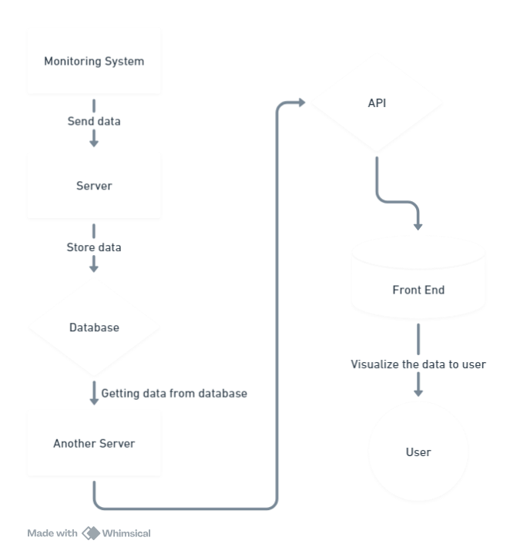
IDEA AND SOLUTION
Monitoring System to Server: The monitoring system collects data (e.g., air quality) and sends it to the first server.
Server to Database: The server stores the collected data in a database for further access.
Database to API Server: Another server retrieves data from the database and creates an API to make the data accessible.
API to Frontend Dashboard: The frontend (Air Pollution Monitoring Dashboard) uses the API to display data to users in different formats (charts, graphs, tables, etc.).

Slide 4
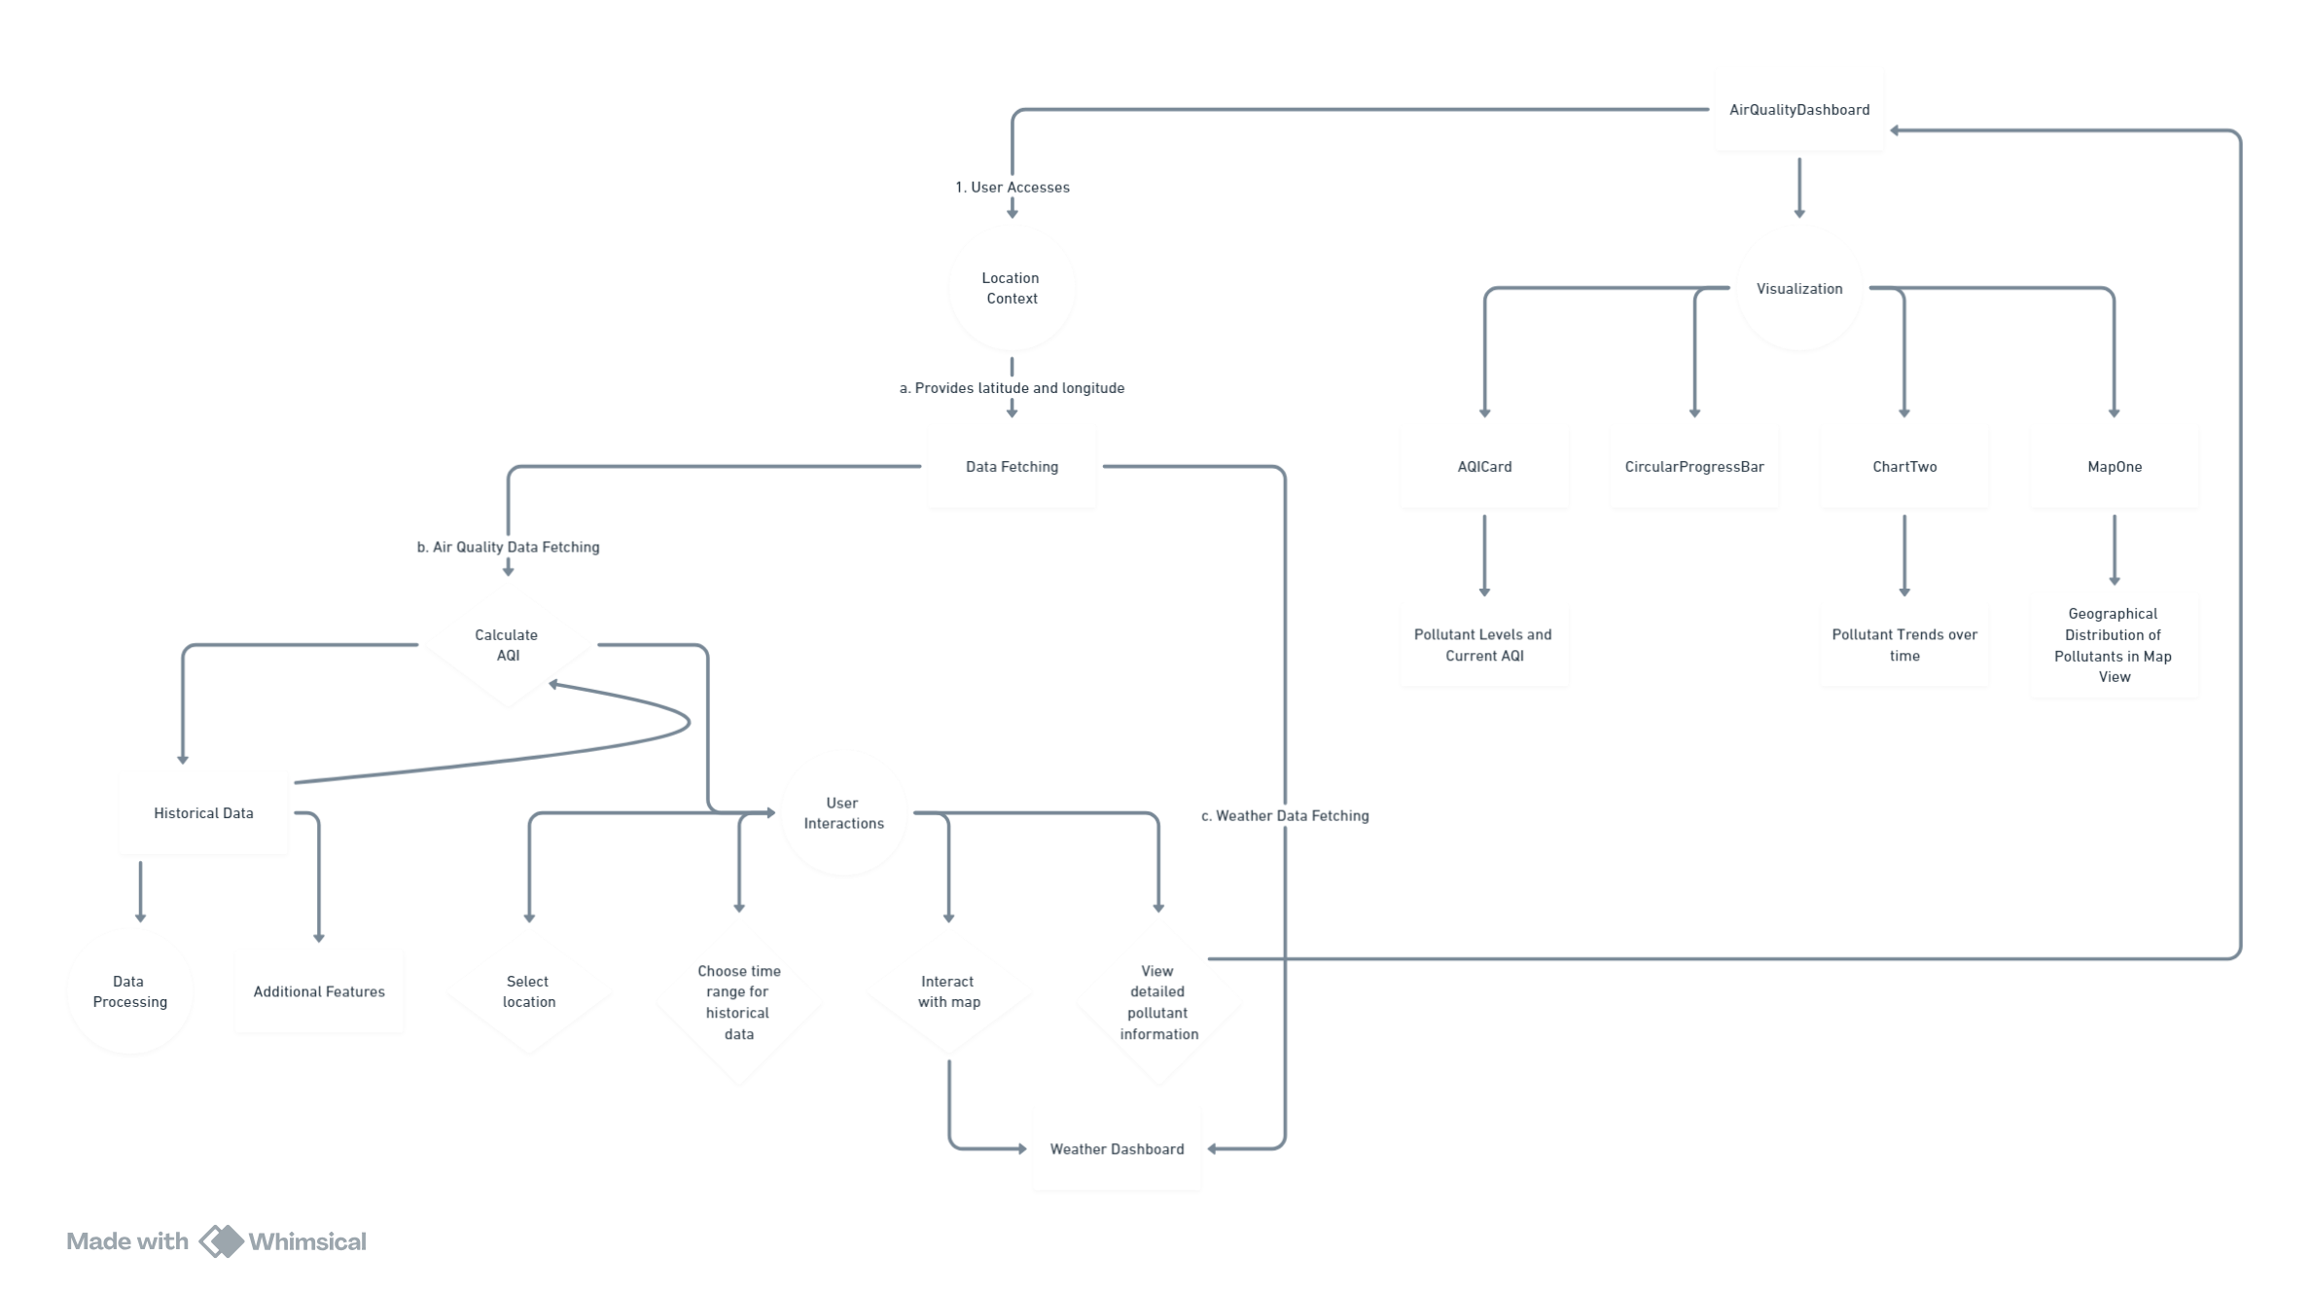
WORKING

Slide 5
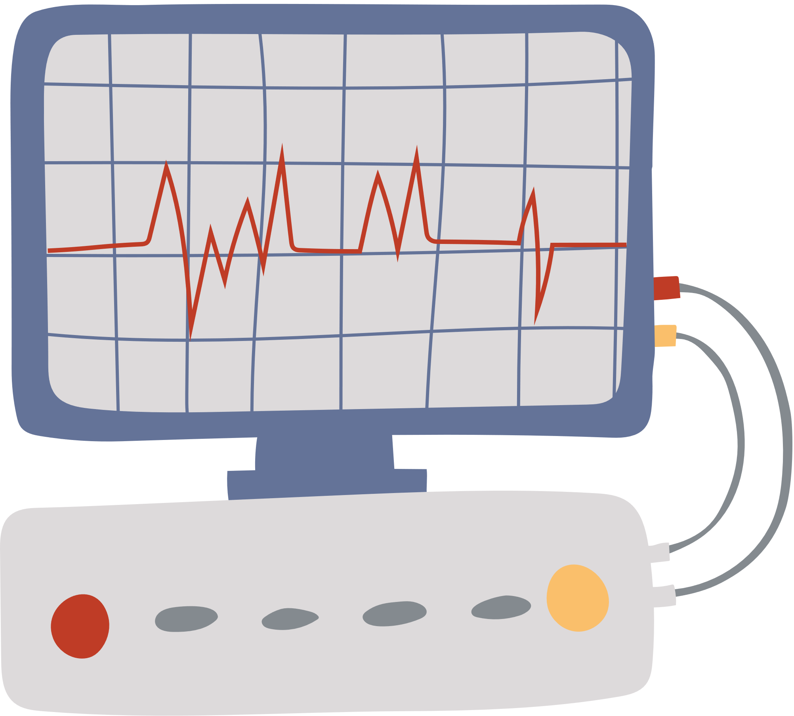







Features
AQI Monitoring
AQI Heatmap
Ai Based
Smart Chatbot
AQI Sharing
Alerts
Historical Trends
Interactive Maps

Slide 6










Features
Seamless Authentication
profile & Personalization
Personalized Reccomandations
Comprehensive Wether info
ECO Games
Awareness
Guidence
Most Polluted Cities
least Polluted Cities
Metropolitan Cities data

Slide 7





Thank You
Increasing green spaces in cities, such as parks and green roofs, helps improve air quality. Trees and plants absorb pollutants and provide oxygen, creating a healthier environment for city residents.

